Slide 1
school and universities
lock-down
start to
lock-down
External R_{t}
REACT
ONS

Slide 4
school and universities
lock-down
start to
lock-down
External R_{t}
REACT
ONS

Slide 5
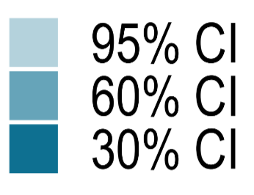
In Beds
(Imputation)
In Beds
(Observation)
Estimated though
in Beds dara

Slide 6
school and universities
lock-down
start to
lock-down
External R_{t}
REACT
ONS

Slide 8
External Data
REACT
ONS
Oxford
Glasgow

Slide 9
External Data
REACT
ONS
Oxford
Glasgow

Slide 10
Sampling
effect

Slide 11
Sampling
effect

Slide 14
school and universities
lock-down
start to
lock-down
External R_{t}
REACT
ONS

Slide 16
External Data
REACT
ONS
Oxford
Glasgow

Slide 18
Sampling
effect

Slide 19
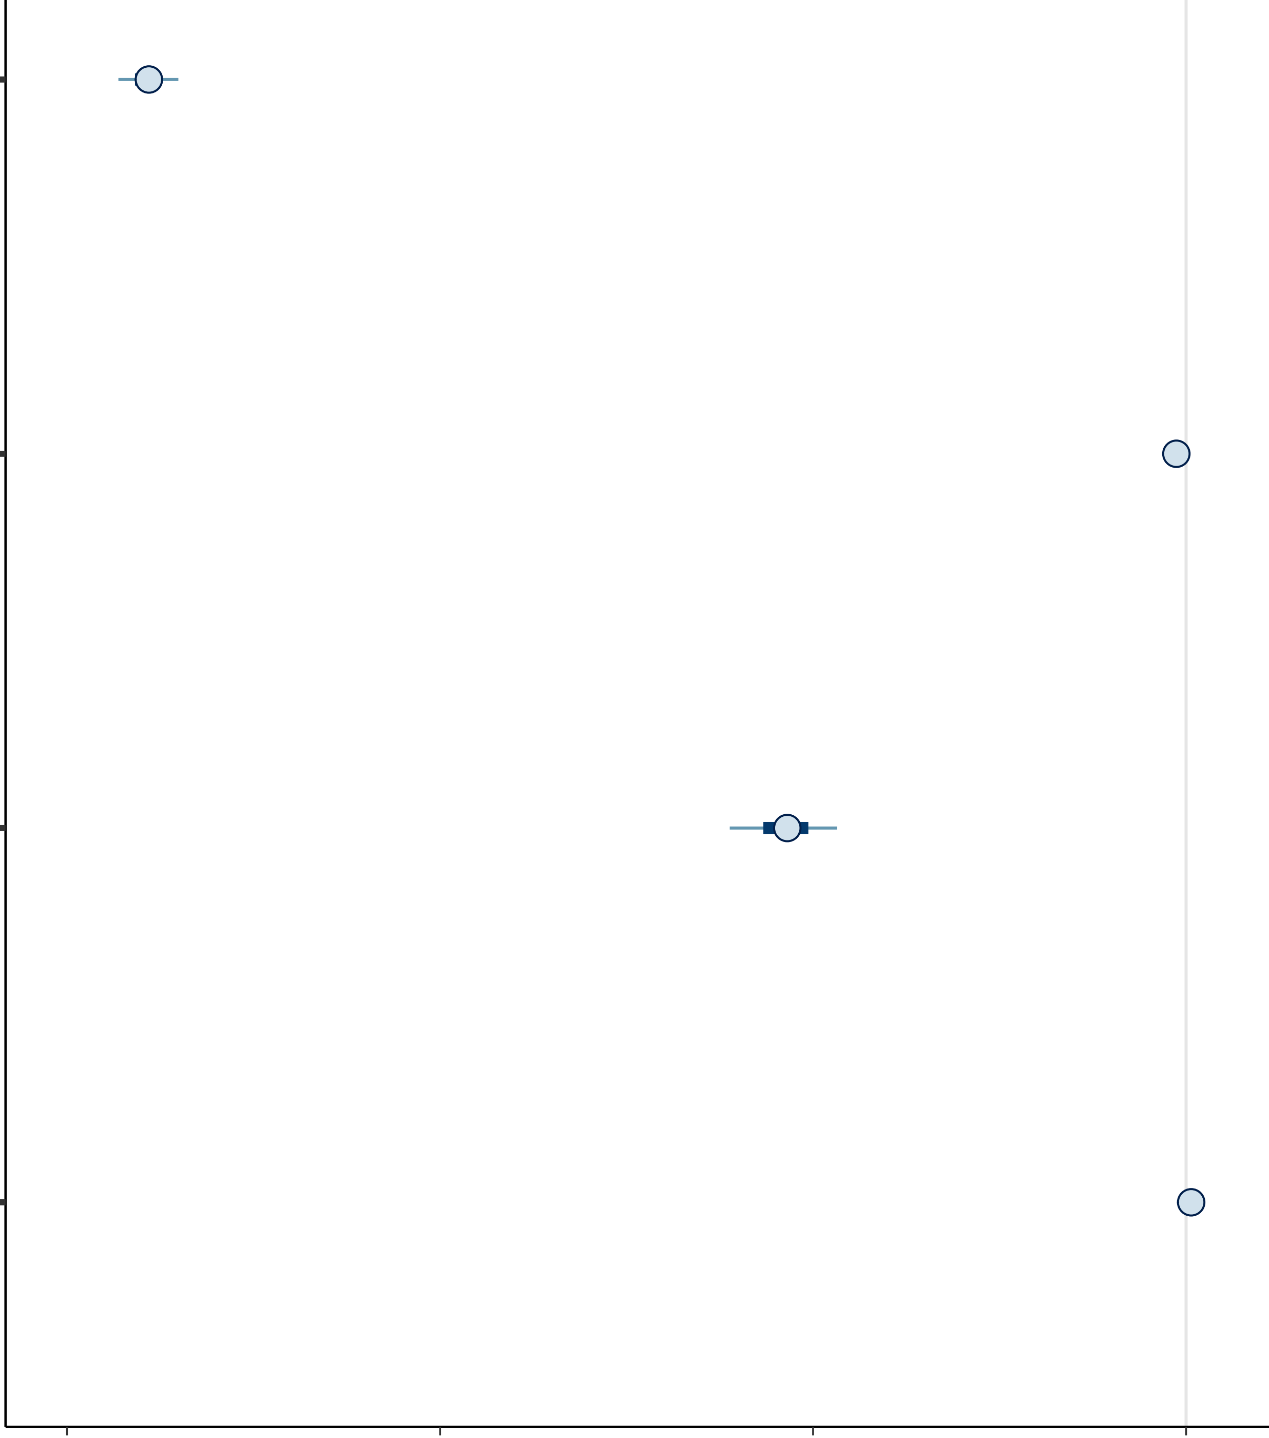
Intercept
Protest
Schools and Universities
Lock-down
-1.2
-0.8
-0.4
0.0

